Slide 1
Intelligent Movie Recommender
Raghav Khandelwal (011895398)
Sanjeev Sreekumar Krishnan (011915113)
Shruti Mallesh (11914432)
Gautham Krishna Chakkalaparambil Sajeev (01191418)

Slide 2
Introduction
Recommender systems predict user preferences
Our goal: build a personalized movie rating predictor
Uses both:
User–movie interaction (collaborative filtering)
Movie/user metadata (content-based)
Produces:
Predicted rating (0.5–5.0)
Top-10 recommendations

Slide 3
Motivation
Ratings dataset is sparse
Cold-start movies have little interaction data
Metadata helps model movies more accurately
Hybrid systems outperform pure CF
Aim: improve prediction accuracy and provide better recommendations

Slide 4
Problem Definition
Input: user ID + movie metadata
Output: predicted rating + top-K recommendations
Objective: reduce RMSE/MAE, improve ranking quality
Combine collaborative + content-based information

Slide 5
Project Goal
Learns latent representations via PMF
Enhances them using metadata from TMDB
Improves prediction accuracy and semantic coherence
Provides real-time recommendation via Streamlit

Slide 6
Datasets
MovieLens 20M
20M ratings
After filtering:
  138,493 users
  15,451 movies
  ~19.9M ratings
TMDB
Genres
Cast & crew
Keywords
Budget, revenue, runtime, popularity
TF-IDF overview text embeddings

Slide 7
Metadata Processing Pipeline
Movie Metadata Includes:
Genre one-hot vectors
Cast/crew frequency encodings
Keywords
Numeric features (budget, popularity…)
TF-IDF embeddings (500-dim)
User Metadata:
Aggregated metadata of rated movies

Slide 8
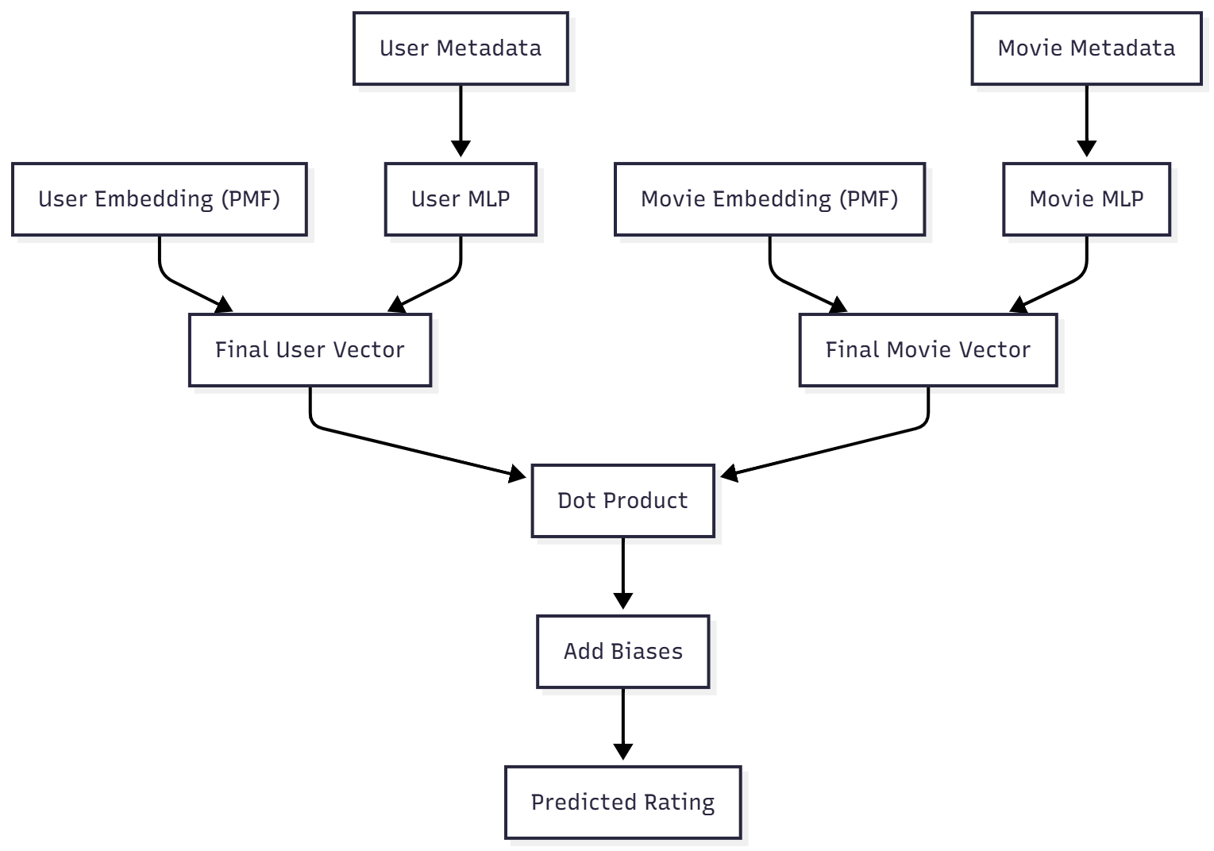
Model Architecture
Hybrid Model Workflow:
PMF produces base embeddings
Metadata → MLP → correction vectors
Final user/movie vectors = PMF + correction
Dot product + biases → rating

Slide 9
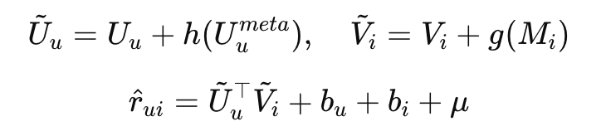
Mathematical Formulation
h, g = MLP projections
U = aggregated user metadata
M = movie metadata vector

Slide 10
Training Setup
Optimizer: Adam (LR = 5×10⁻⁴)
Batch size: 4096
Embedding dimension: 32
Dropout: 0.2
Epochs: 15
Train/Test split: 80/20

Slide 11
Baseline Comparison
Model | RMSE | MAE | Precision@10 | Recall@10
PMF | 0.832 | 0.832 | 0.184 | 0.129
Metadata-only | 0.871 | 0.651 | 0.161 | 0.112
Hybrid | 0.805 | 0.605 | 0.212 | 0.148

Slide 12
Case Study: Recommendations
PMF only:
Shows popular mainstream titles
Less personalized
Hybrid Model:
Better genre alignment
Includes relevant long-tail titles
Shows increased diversity

Slide 13
Streamlit Application
Features:
Movie Search
Rating prediction
Personalized Top-10 recommendations
Fast vectorized inference
Interactive UI

Slide 14
Limitations
Metadata quality varies
TF-IDF lacks semantic depth
PMF is linear → cannot capture higher-order interactions
No temporal modeling

Slide 15
Future Work
Use transformer embeddings (BERT/SBERT/LLM-based)
Deep hybrid recommenders (NeuMF, LightGCN)
Sequence-aware recommenders (SASRec, GRU4Rec)
Multi-modal (posters, trailer audio, LLaVA-like models)
Reinforcement learning for long-term user satisfaction

Slide 16


